Slide 1
Edinburgh, Scotland
Made by: Iris Haasjes and Britt Heusinkveld.

Slide 2
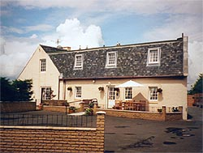
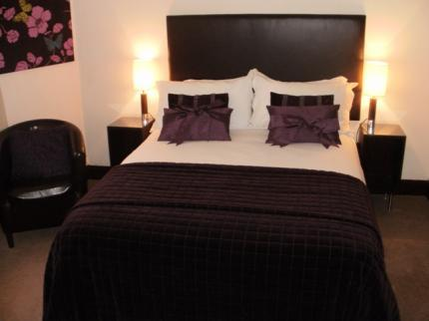
Our stay
We are staying in the Aaron Glen Guesthouse, in Edinburgh itself.

Slide 3
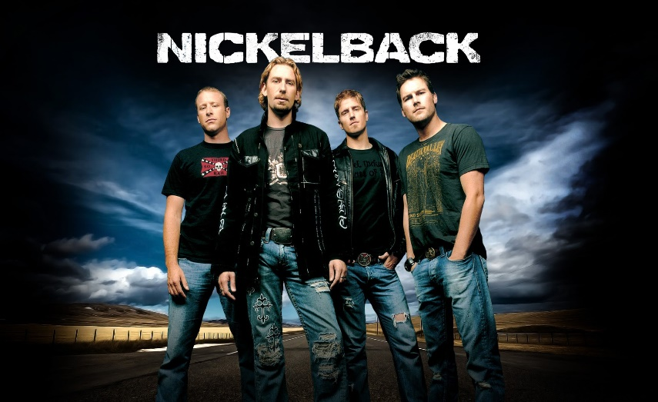
Activity one
On Monday October 24th we’re going to a concert in Glasgow (Nickelback) right after we land in Edinburgh we have a walk around the accommodation and at 3pm we have to pick up our rental car. At half past 5 we leave for the concert, on our way we’re having dinner at Darcy’s.

Slide 4
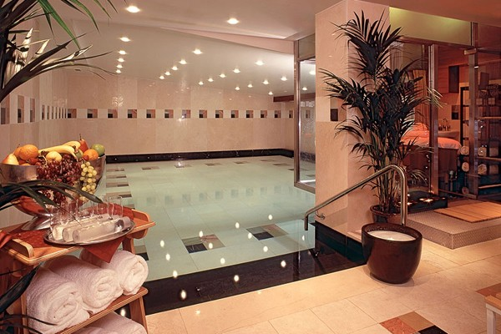
Activity two
On day two we’re having a more relaxed day, since our first day was kinda rough. We are going to the Spa.

Slide 5
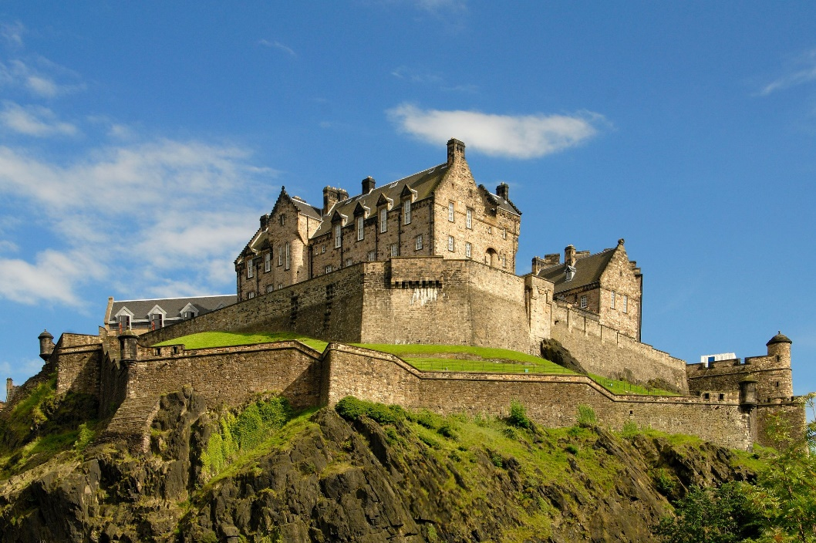
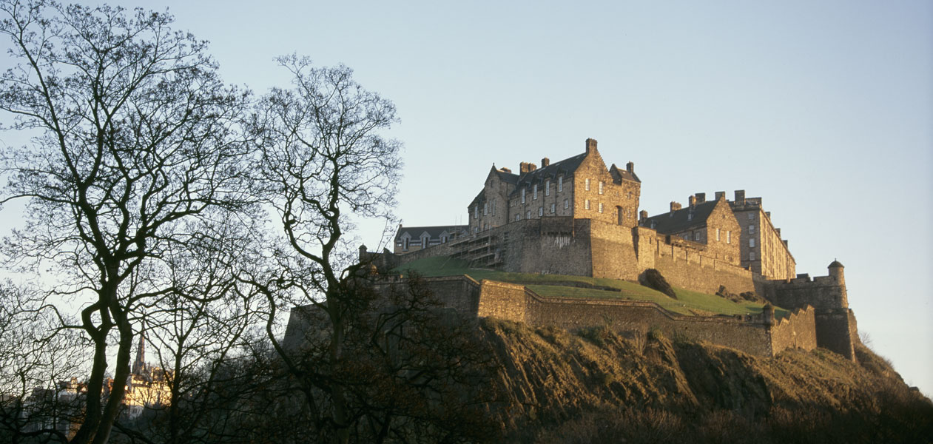
Activity three
On day three we’re going historic, we are visiting the Edinburgh castle. It’s a historic fortress which dominates the skyline of the city. It’s Scotland’s most-visited paid tourist attraction. The castle has become a recognizable symbol.

Slide 6
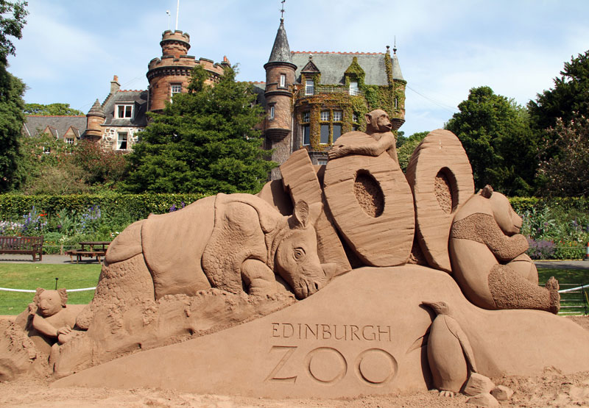
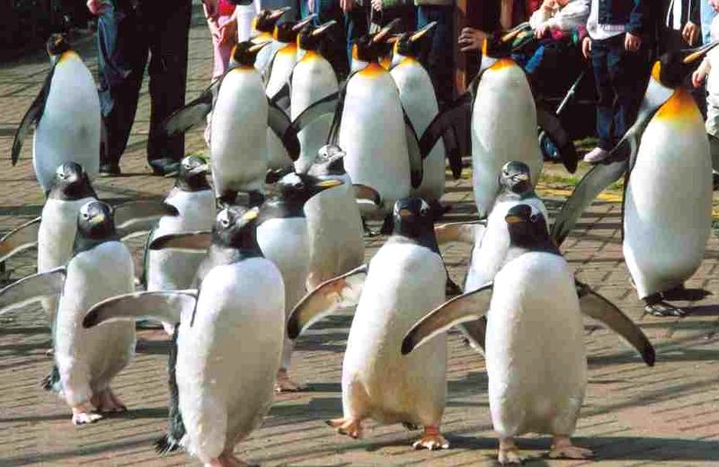
Activity four
On Thursday, day four we are going to the zoo. We’re strolling down the park for the whole day.

Slide 7
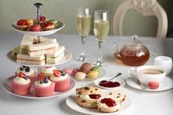
Activity five
On our last day in Edinburgh we’re having a afternoon tea for two, in the Kabin. We are leaving Edinburgh at 6:40 pm, but we first have to bring back our rental car (4pm) We arrive back in the Netherlands at 9:15 pm.

Slide 8
The end.

